Slide 1
Foundation for Excellence
Growth Measurement
Presented By: Growth Measurement Subcommittee
Rhea McIver Gibbs, Ed.D, Lead Personnel Agent
Rhonda Kramer, Lead Personnel Agent
July 21, 2021

Slide 2
Foundation for Excellence Presentation
Introduction
Setting the Foundation – Carol Mehochko, Academic Agent, Special Programs
Foundation for Excellence and Growth Measurement Indicators
Michael Arrington – Therapeutic Behavioral Strategist, Special Services
Dr. Dawn Bowman – High School Assistant Principal, Rialto
Dr. Maria Ordaz – Elementary Assistant Principal, Dunn
Reflection Plan for Growth Measurement
Carolyn Eide – Middle School Principal, Jehue
Todd Harris – Middle School Assistant Principal, Kolb
Carol Mehochko – Academic Agent, Special Programs
Juan Sedano - Supervisor, Nutrition Services
Review of Growth Measurement Tools
Roxanne Dominguez, Academic Agent, Special Services
Dr. Eboni Kemp – Elementary Principal, Kordyak
Committee Recognition
Notes:
https://unsplash.com/photos/IoCWq07GaG4

Slide 3
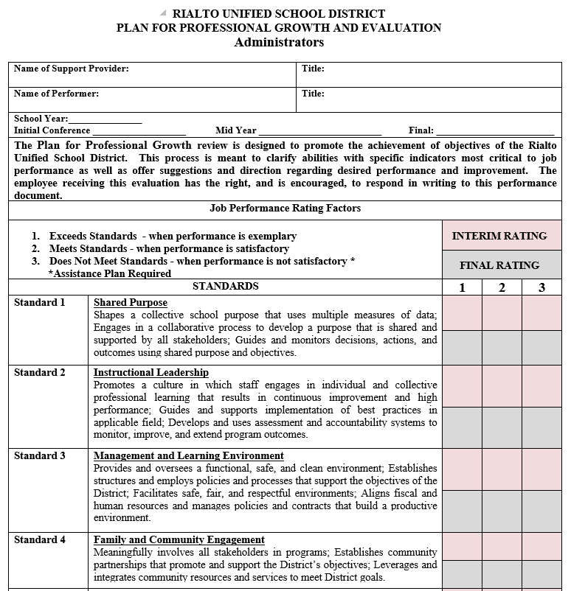
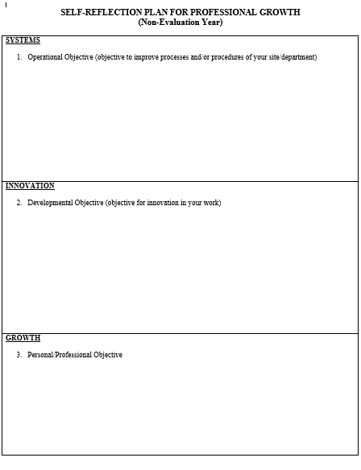
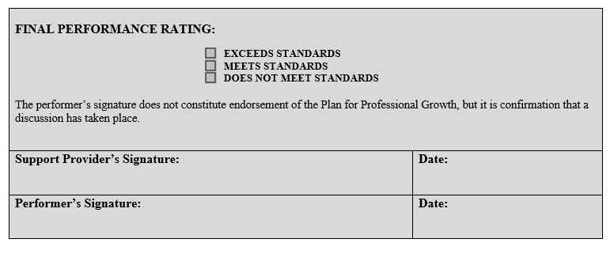
The Journey of a Thousand Miles Begins with a Single Step ...
Approximately six years ago, management evaluation forms were revised and aligned with the California Professional Standards for Education Leaders (CPSELs).

Slide 4
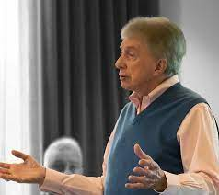
Dr. Cook - Class: The Social Order
Class is not determined by conformity to criteria. It is, rather, subjective, the living expression of character arising from the person's essential triune nature – Body, Soul, and Spirit, one necessarily chosen as a dominant "way of life."

Slide 5
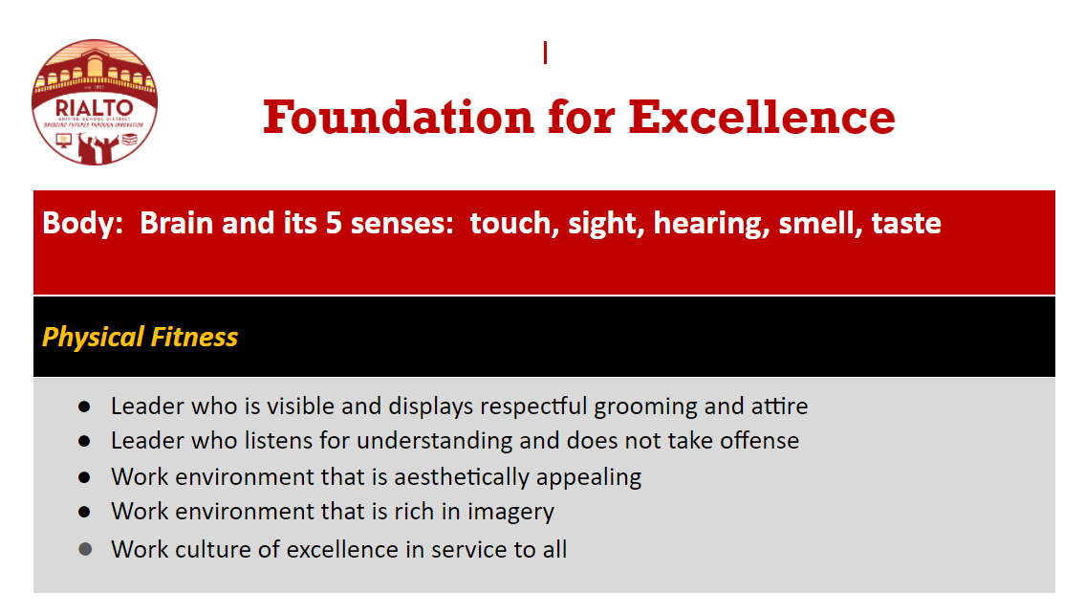
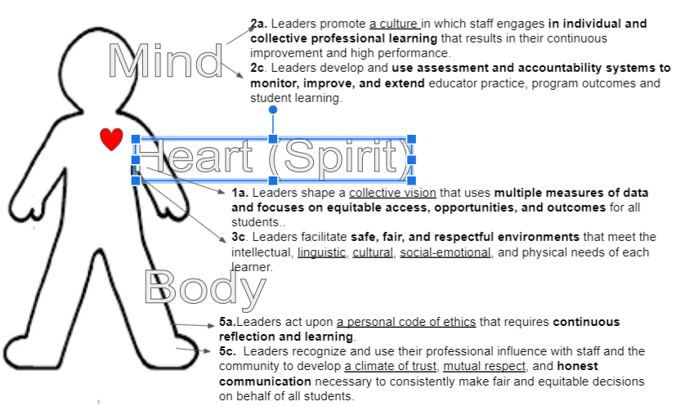
Principal Support Providers During the 2020-21 School Year
Charged with incorporating Body, Soul, and Spirit in the Principal goal setting and evaluation process.
Committee was formed by Personnel Services of various stakeholders to revise documents and the process for all administrators, confidential, and supervisory employees.

Slide 6
Foundation for Excellence – Body, Soul, and Spirit
Body: Brain and its five (5) senses: touch, sight, hearing, smell, taste
Physical fitness
Leader who is visible and displays respectful grooming and attire
Leader who listens for understanding and does not take offense
Work environment that is aesthetically appealing
Work environment that is rich in imagery
Work culture of excellence in service to all
Notes:
https://unsplash.com/photos/IoCWq07GaG4

Slide 7
Foundation for Excellence – Growth Measurement Indicators
Body: Brain and its five (5) senses: touch, sight, hearing, smell, taste
Physical fitness
Leader who is visible and displays respectful grooming and attire
Strengthens participation, engagement, connection, support, and sense of belonging with others
Leader who listens for understanding and does not take offense
Recognizes and uses professional influence with staff and the community to develop a climate of trust, mutual respect, and honesty
Work environment that is aesthetically appealing
Ensures a functional, safe, and clean environment
Work environment that is rich in imagery
Reviews the physical plant and grounds to ensure the imagery reflects the demographics of the educational community
Work culture of excellence in service to all
Encourages and inspires others to higher levels of performance, commitment, and motivation by modeling
transparent and responsible actions
Notes:
https://unsplash.com/photos/IoCWq07GaG4

Slide 10
Foundation for Excellence – Body, Soul, and Spirit
Soul: Mind and its three (3) functions: cognition, understanding, knowledge
Mental Fitness
Leader who relates all actions to the organization’s purpose
Leader who sees what others do not see and is able to inspire vision in others
Work culture that promotes awareness and understanding of operational realities
Work culture that fosters profound knowledge
Work culture that evokes intellectual ingenuity
Notes:
https://unsplash.com/photos/IoCWq07GaG4

Slide 11
Foundation for Excellence – Growth Measurement Indicators
Soul: Mind and its three (3) functions: cognition, understanding, knowledge
Mental Fitness
Leader who relates all actions to the organization’s purpose
Shapes a collective purpose by using multiple sources of data
Uses evidence to create and shape plans, programs, and activities that advance the District's mission
Leader who sees what others do not see and is able to inspire vision in others
Creates and shapes conditions that promote innovation
Builds shared responsibility to achieve the District’s mission by distributing leadership roles and responsibilities among staff and community
Notes:
https://unsplash.com/photos/IoCWq07GaG4

Slide 12
Foundation for Excellence – Growth Measurement Indicators
Soul: Mind and its three (3) functions: cognition, understanding, knowledge
Mental Fitness
Work culture that promotes awareness and understanding of operational realities
Serves at an expert level in their job responsibilities and knows the roles of others in their service areas and school sites
Communicates the District’s mission so that the staff and community understands it and uses it for decision-making
Work culture that fosters profound knowledge
Promotes a culture in which staff engages in individual and collective professional learning that results in continuous innovation and high performance
Capitalizes on the diverse experiences and abilities of staff to plan, implement, and assess professional learning
Notes:
https://unsplash.com/photos/IoCWq07GaG4

Slide 13
Foundation for Excellence – Growth Measurement Indicators
Soul: Mind and its three (3) functions: cognition, understanding, knowledge
Mental Fitness
Work culture that evokes intellectual ingenuity
Participates in opportunities that develop greater understanding of the District
Communicates expectations and supports professional actions that reflects ethics, integrity, and social justice
Notes:
https://unsplash.com/photos/IoCWq07GaG4

Slide 14
Foundation for Excellence – Body, Soul, and Spirit
Spirit: Powers of the heart: reason, truth, judgment, conscience, imagination, intuition, will
Spiritual Fitness
Leader who exercises agency in self and others
Leader who is thoughtful, reasonable, and confident
Work culture that creates kindness through empathy and personal honor
Work culture that evokes risk-taking
Work culture that inspires imagination
Notes:
https://unsplash.com/photos/IoCWq07GaG4

Slide 15
Foundation for Excellence – Growth Measurement Indicators
Spirit: Powers of the heart: reason, truth, judgment, conscience, imagination, intuition, will
spiritual Fitness
Leader who exercises agency in self and others
Exercises their ability to make decisions and encourages others to do the same
Sustains motivation, commitment, energy, and health by balancing professional and personal responsibilities
Leader who is thoughtful, reasonable, and confident
Considers options and consequences that do not compromise their integrity and that of the District
Reflect on areas for improvement and takes responsibility for change and growth
Notes:
https://unsplash.com/photos/IoCWq07GaG4

Slide 16
Foundation for Excellence – Growth Measurement Indicators
Spirit: Powers of the heart: reason, truth, judgment, conscience, imagination, intuition, will
spiritual Fitness
Work culture that creates kindness through empathy and personal honor
Personifies honorable and compassionate service to others
Acknowledges, accepts, and values, all students, families, and staff by supporting and encouraging them to realize their highest aspirations
Work culture that evokes risk-taking
Provides opportunities, resources, and support to others to ignite their ideas without judgment
Fosters a culture where risk-taking is valued that positively impacts the education and well-being of all students
Notes:
https://unsplash.com/photos/IoCWq07GaG4

Slide 17
Foundation for Excellence – Growth Measurement Indicators
Spirit: Powers of the heart: reason, truth, judgment, conscience, imagination, intuition, will
spiritual Fitness
Work culture that inspires imagination
Embraces diverse perspectives and creates opportunities to imagine different solutions
Encourages and inspires others to higher levels of performance
Notes:
https://unsplash.com/photos/IoCWq07GaG4

Slide 18
Reflective Growth Process
Process
Initial conversation – Beginning of the year
Continuous communication – before and after Interim
Summative conversation - Final
Initial conversation
Collaboration with emphasis on reflection and growth is important as the two parties build a trusting and genuine relationship
Discuss strengths and areas of growth based on reflection and set growth goals
Continuous communication
Check in continuously with the evaluatee to support, provide recommendations and check on progress towards goals prior to the Interim so there are no surprises
Collaborate prior to the Interim to establish congruence
Following the Interim, continue to check in to continue the conversation
Summative conversation
Evaluatee writes reflections on goals and growth areas and submits to evaluator
Collaborate and discuss the growth areas and goals
With continuous conversations, there should be no surprises
Notes:
https://unsplash.com/photos/IoCWq07GaG4

Slide 19
Measureable Mutual Commitments and Expectations
Thank you Educational Services!
Video presentation of a conversation between an evaluator and evaluate setting goals for the new school year (MMC&Es).
The video will be available on the Summer Strategics App and in the Google folder.
Thank you video participants– Beth Curtiss, Lead Academic Agent Elementary Innovation
Dr. Marina Madrid, Agent: Multilingual Programs
Notes:
https://unsplash.com/photos/IoCWq07GaG4

Slide 20
Measurable Mutual Commitments and Expectations
Body
I will be visible on campus.
So that students and staff will be supported emotionally and I will build relationships.
My specific commitments are to be in classrooms two full days a week and visible during transition times.
Strategic Plan: Strategy II; Action Plan III
Support Needed: Protected time on my calendar
Performance outcome: Classroom visitation logs; improved campus culture (measured by surveys)
Soul
I will complete all of the Think Together Snack Evaluations by November 30th (State deadline is January 31st).
So that I allow time for rescheduling and corrections that may be needed.
My specific commitments are to do two evaluations per week in the course of fifteen weeks.
Strategic Plan: Strategy III; Action Plan V
Support Needed: Think Together Leads and Staff
Performance outcome: Track the number of sites that have been evaluated; check-in monthly to track my specific goal
Notes:
https://unsplash.com/photos/IoCWq07GaG4

Slide 21
Measurable Mutual Commitments and Expectations
Spirit
I will greet my employees on a daily basis.
So that I will be approachable to staff and improve overall work morale.
My specific commitments are to walk the floor/campus (nutrition services) every two hours and greet someone I have not spoken to that day. My goal is to speak to at least three employees each day.
Strategic Plan: Strategy IV; Action Plan II
Support Needed: No additional support needed
Performance outcome: Create a spreadsheet to log the names of each employee I speak to; Staff satisfaction measured by end-of-the-year staff feedback surveys
Spirit I will meet with my custodial team weekly to have a stand-up share out.
So that each custodian can share out on their particular area of responsibility, which in turn creates a work culture of pride and excellence.
My specific commitments are to meet with my custodial team weekly to give them the opportunity to share out accomplishments or concerns related to their specific areas. I will make my custodial staff feel valued.
Strategic Plan: Strategy V; Action Plan V (Welcoming and friendly school environment)
Support Needed: District M&O; custodial equipment and supplies
Performance outcomes: Measured through meeting notes of the weekly share outs;
visually well maintained school campus
Notes:
https://unsplash.com/photos/IoCWq07GaG4

Slide 22
Measureable Mutual Commitments and Expectations
Let’s Practice – https://tinyurl.com/c82c6pp4
I will do this:
So that:
My specific commitments are:
Support needed:
Performance outcome(s):
I will do this: Ensure District curriculum implementation
So that: Newly developed curriculums are used effectively in the classroom
My specific commitments are: All science teacher will effectively implement the new science curriculum by December 1
Strategic Plan: (site plan or District plan)
Support needed: District curriculum coordinator; site administration staff; science department chair
Performance outcome(s): (what is the expected and actual outcomes based on data)
Notes:
https://unsplash.com/photos/IoCWq07GaG4

Slide 23
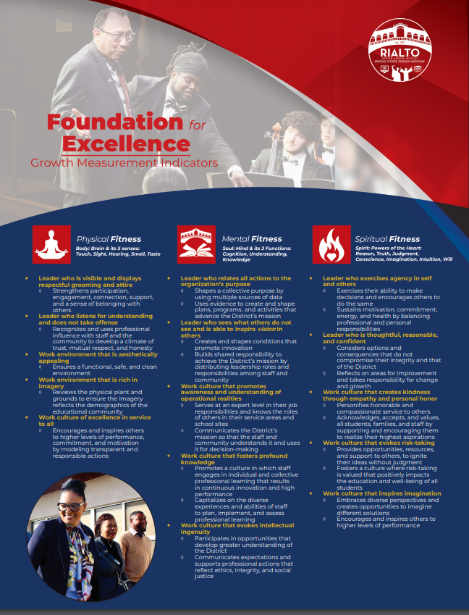
Growth Measurement Tools
Insert
Notes:
https://unsplash.com/photos/IoCWq07GaG4

Slide 24
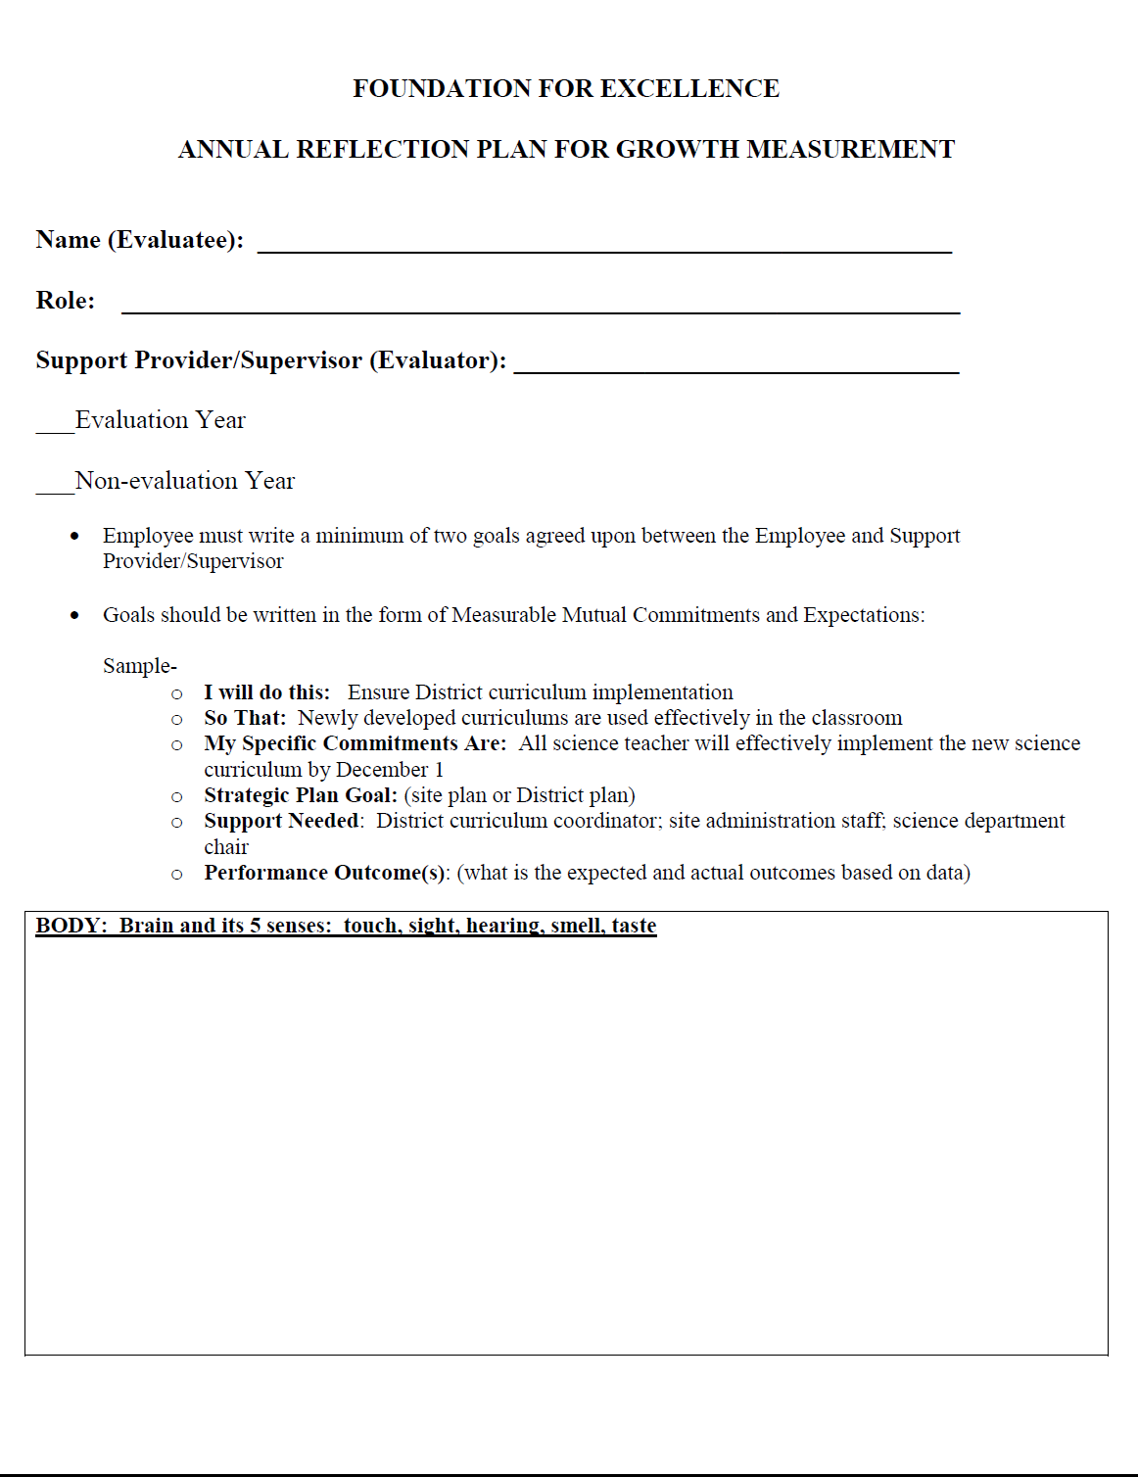
Growth Measurement Tools
Annual Reflection Plan for Growth Measurement
The Annual Reflection Plan for Growth Measurement will be completed every year by Certificated and Classified Management Employees
(Non-Evaluation & Evaluation Year)
Employee must write a minimum of two goals agreed upon between the Employee and Support Provider/Supervisor
Goals should be written in the form of Measurable Mutual Commitments and Expectations:
I will do this:
So that:
My specific commitments are:
Strategic Plan:
Support needed:
Performance outcome(s)
Notes:
https://unsplash.com/photos/IoCWq07GaG4

Slide 25
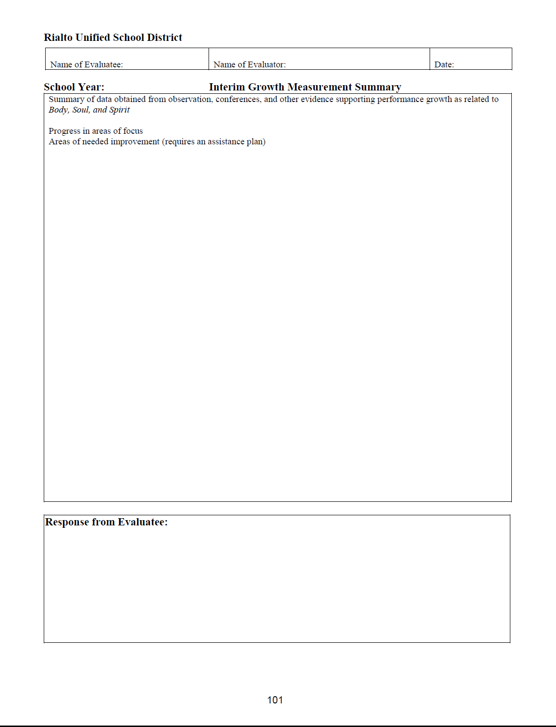
Growth Measurement Tools
Interim Growth Measurement
Interim Growth Measurement Tool is completed during the Certificated and Classified Management Employee’s Evaluation Year.
The assigned Support Provider/Supervisor will provide the Certificated or Classified Management Employee an update on how they are progressing with their goals and performance
Notes:
https://unsplash.com/photos/IoCWq07GaG4

Slide 26
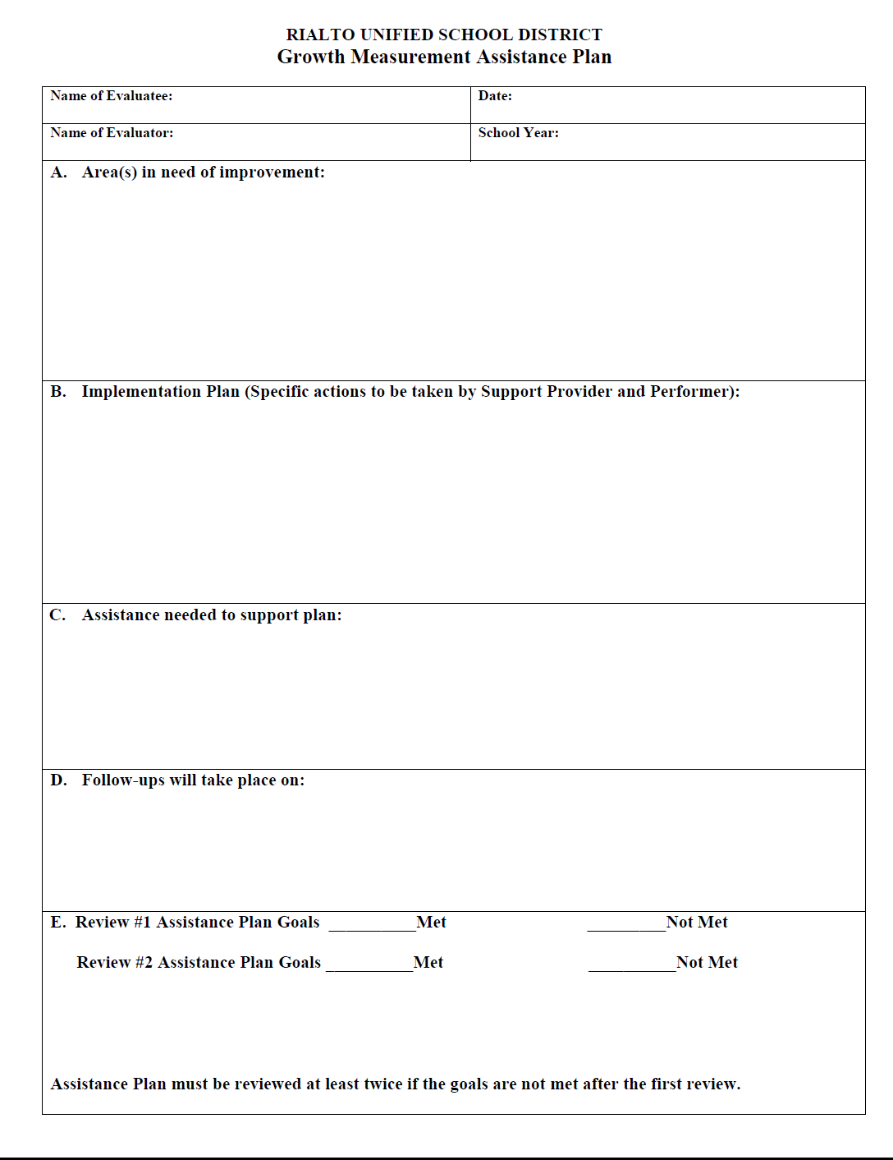
Growth Measurement Tools
Growth Measurement Assistance Plan
The Growth Measurement Assistance Plan will be utilized for Certificated and Classified Management, Confidential and Supervisory employees who require additional support beyond what is already being provided due to performance.
This assistance plan requires a discussion between the Support Provider/Supervisor and the Certificated or Classified Employee, and collaboration towards getting the employee on the right track towards growth and success.
Notes:
https://unsplash.com/photos/IoCWq07GaG4

Slide 27
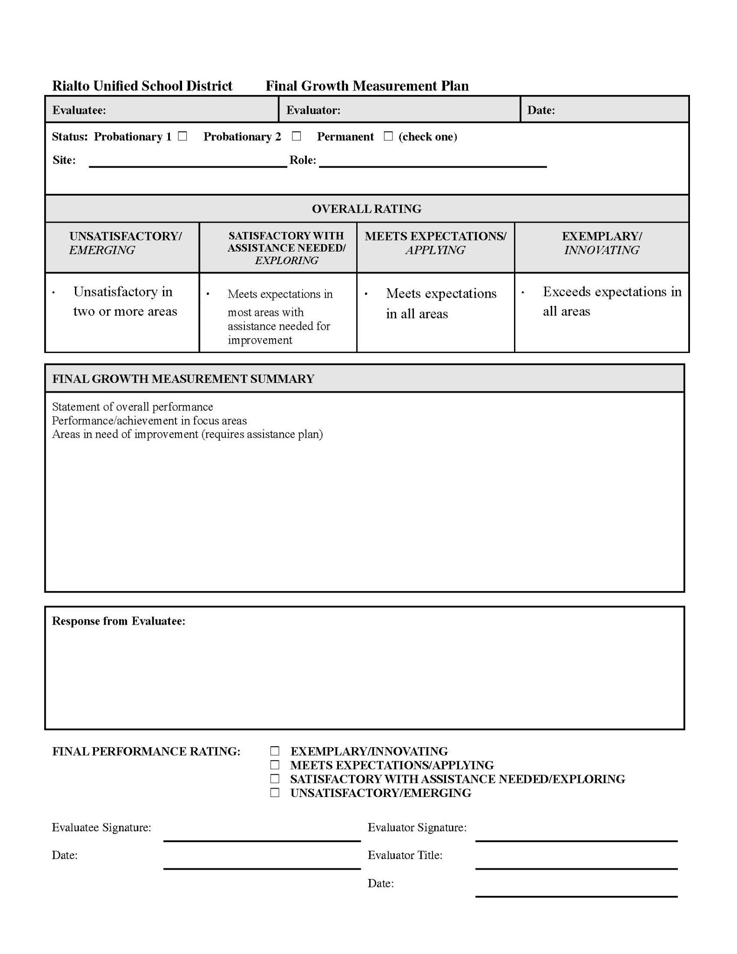
Growth Measurement Tools
Final Growth Measurement
Final Growth Measurement Tool is completed at the completion of the evaluation for Certificated and Classified Management Employees.
The assigned Support Provider/Supervisor will provide the Certificated or Classified Management Employee with feedback on their goals for the year and their overall performance.
The Certificated or Classified Management Employee will receive one of the following ratings:
Exemplary/Innovating
Meets Expectations/Applying
Satisfactory with Assistance Needed/Exploring
Unsatisfactory/Emerging
Notes:
https://unsplash.com/photos/IoCWq07GaG4

Slide 28
Thank You Team Rialto
Notes:
You can safely remove this slide. This slide design was provided by SlideModel.com – You can download more templates, shapes and elements for PowerPoint from http://slidemodel.com

